Slide 1

WHO tools for strengthening emergency care systems
November 2019

Slide 2
WHO TOOLS:
Hospital Emergency Unit Assessment Tool (HEAT)
Essential Resources for Emergency Care
(includes guidance on essential services, medications, supplies at different levels of
the health system, WHO Emergency Care Services Package)
Prehospital Standards and Protocols
Emergency Care Data and Quality Improvement guidance
  Dataset for injury (DSI)
  Dataset for emergency care (DSEC)
  International Registry for Trauma and Emergency Care (IRTEC)
Trauma Care Resources
Emergency Care Systems Framework
Emergency Care System Assessment (National level)
Clinical care training: WHO/ICRC Basic Emergency Care course
Clinical process guidance
  Interagency Integrated Triage Tool (and manual)
  Clinical checklists
  Standardized clinical forms
  Resuscitation area guidance
  Emergency Unit Management (EUM) course

Slide 3
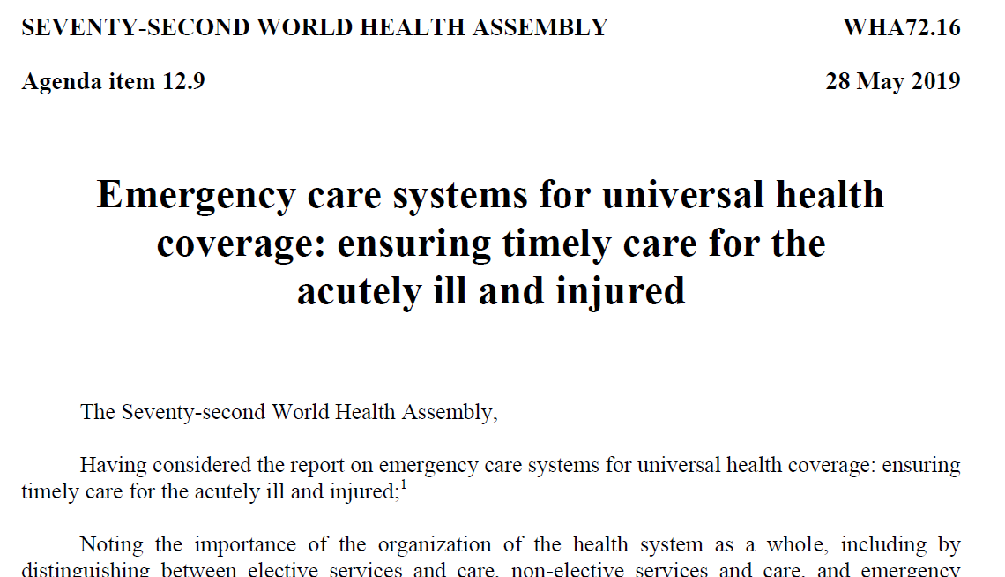
Notes:
https://apps.who.int/gb/ebwha/pdf_files/WHA72/A72_R16-en.pdf?ua=1

Slide 4
WHO Emergency Care System Framework
  Consensus-based essential functions of emergency care systems
  Designed for ministries, policy makers, health system administrators, and general advocacy
  Facilitates the identification of system gaps to aid in priority setting
Notes:
https://www.who.int/emergencycare/emergencycare_infographic/en/
https://www.youtube.com/watch?v=td0AJjUWIpc&feature=youtu.be

Slide 5

Ministry of Health-driven process supported by WHO
Systematic and comprehensive internal assessment of essential components of a national or subnational emergency care system based on the WHO ECS framework
Evaluates system organization, governance, financing, emergency care data, quality improvement, scene care, transport, transfer, referral, facility-based care and emergency preparedness
Generates country-specific action priorities for high impact improvements of emergency care system processes and outcomes
Emergency Care
System Assessment

Slide 6
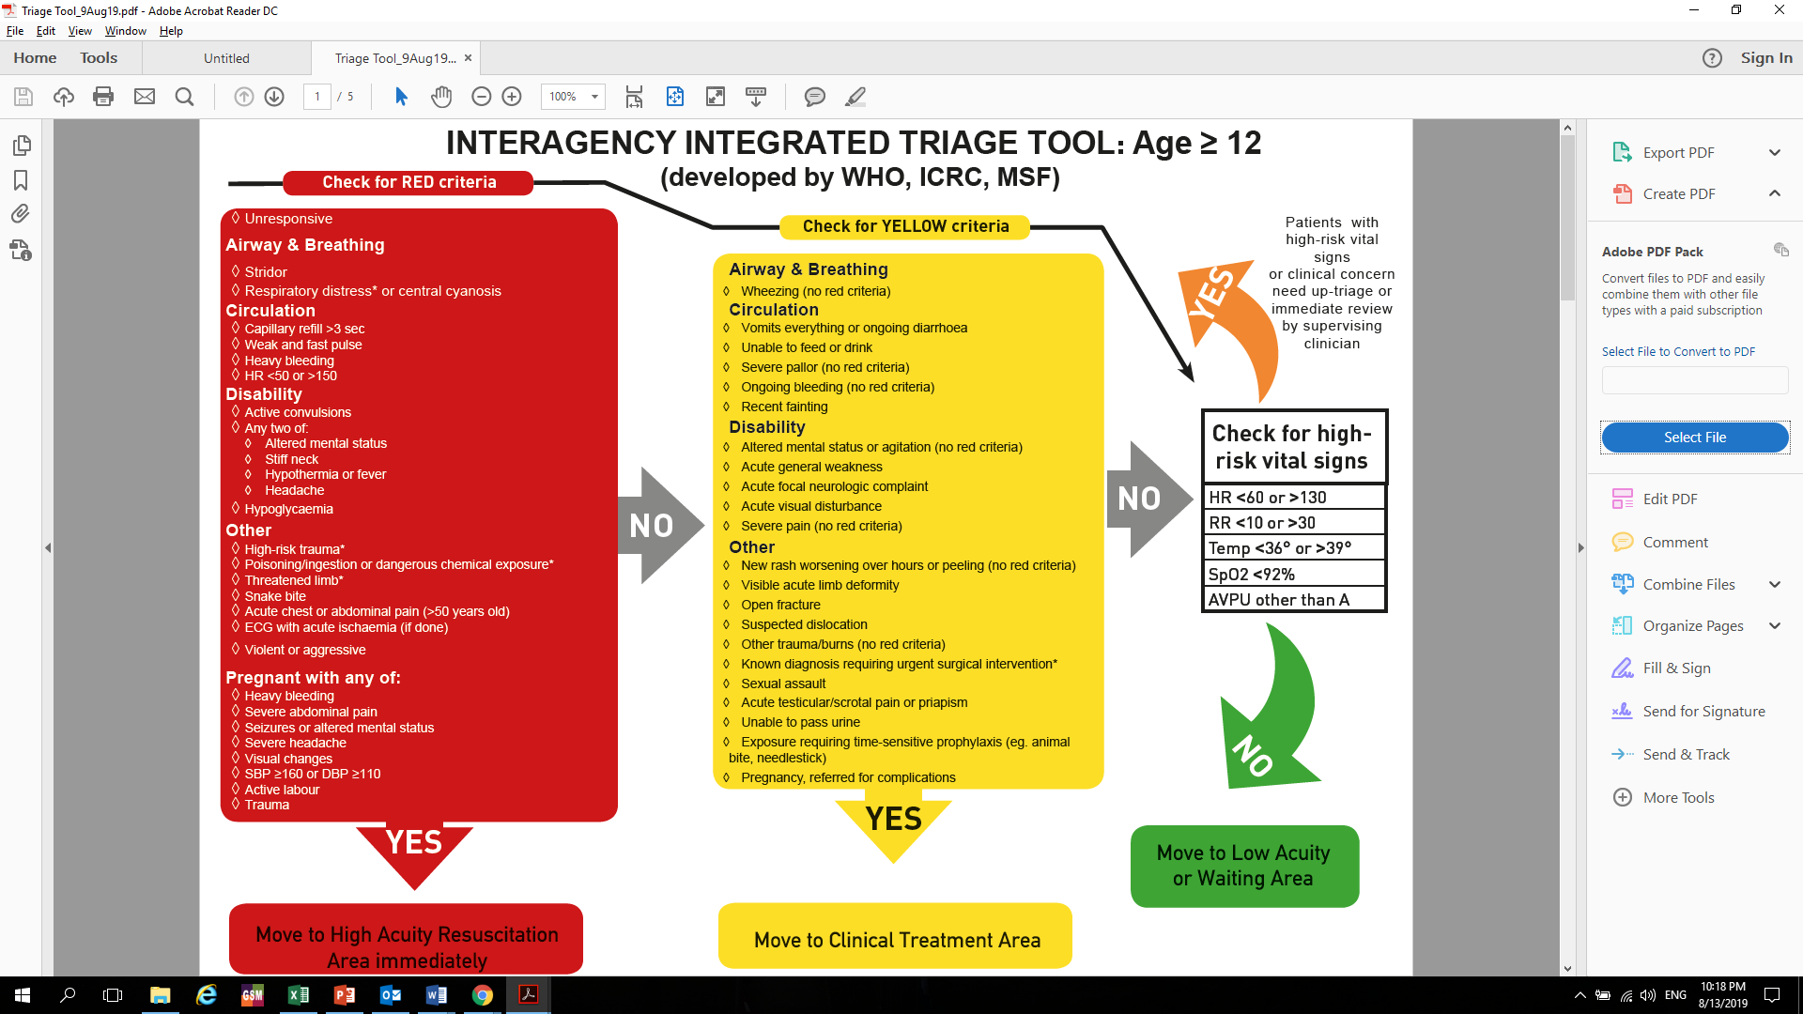
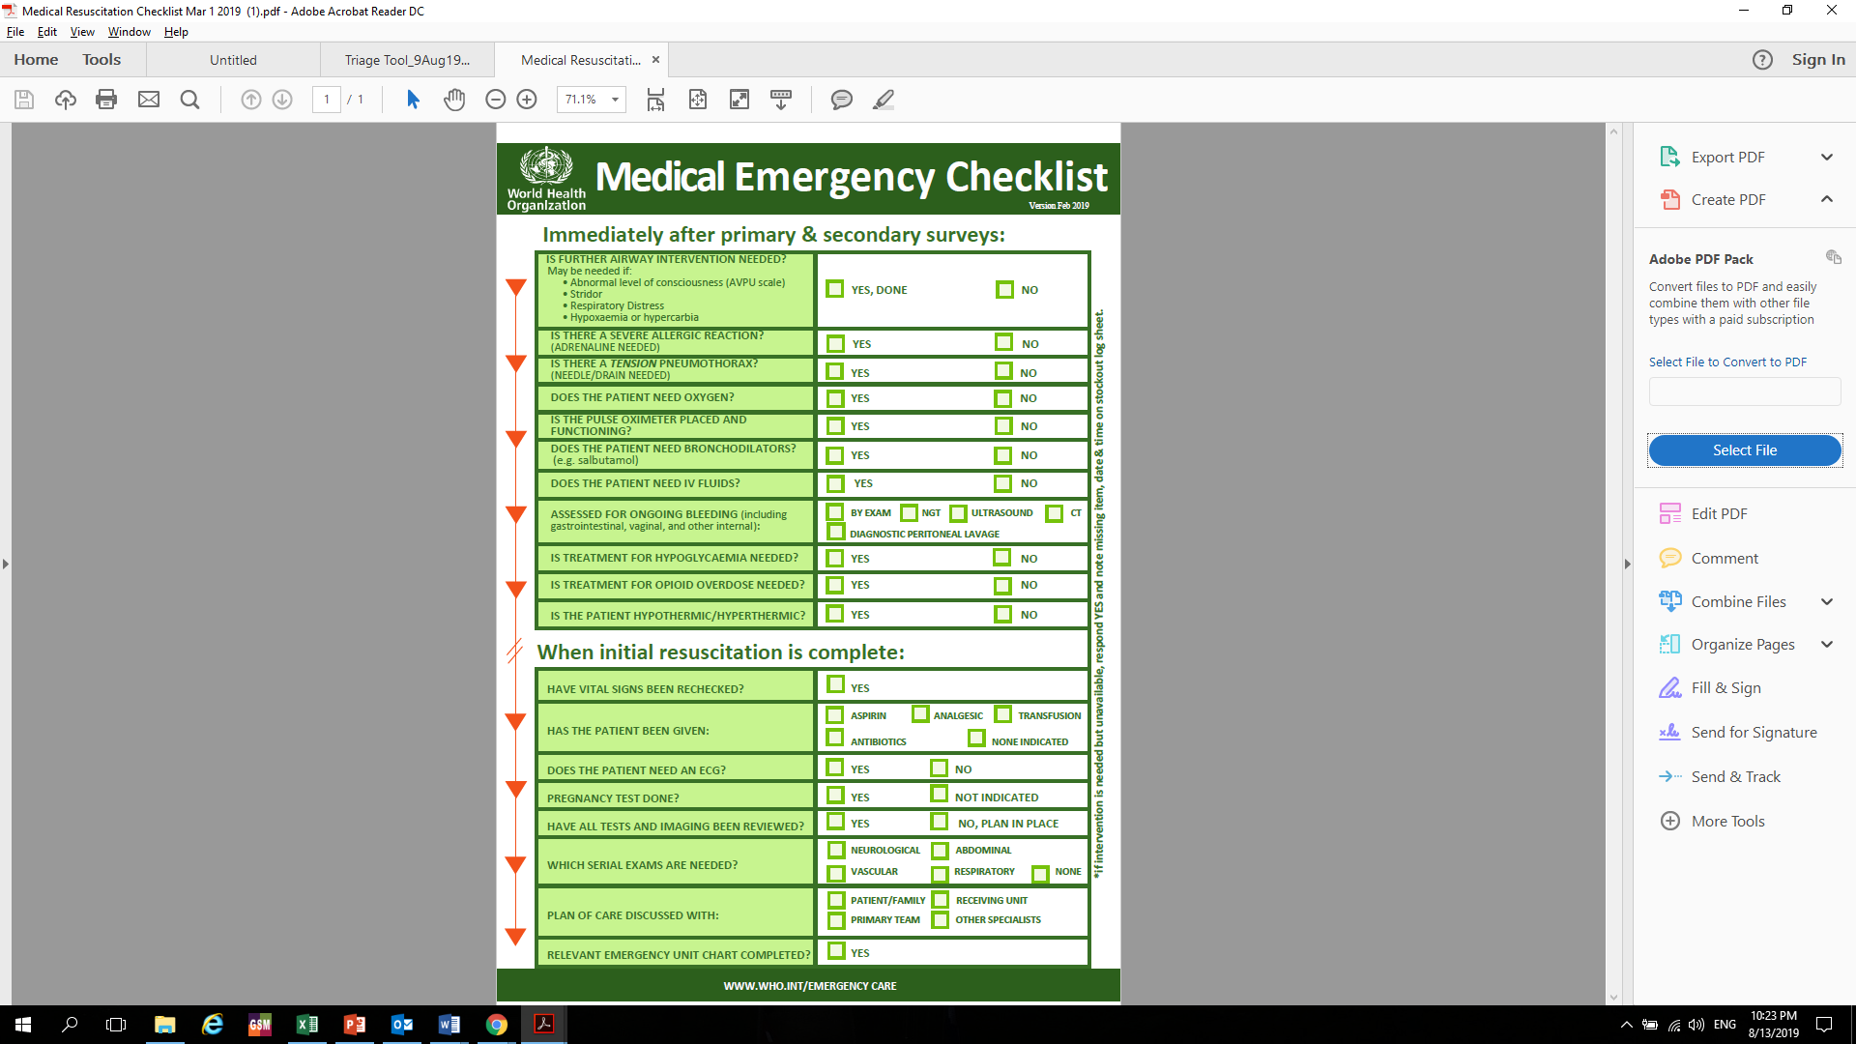
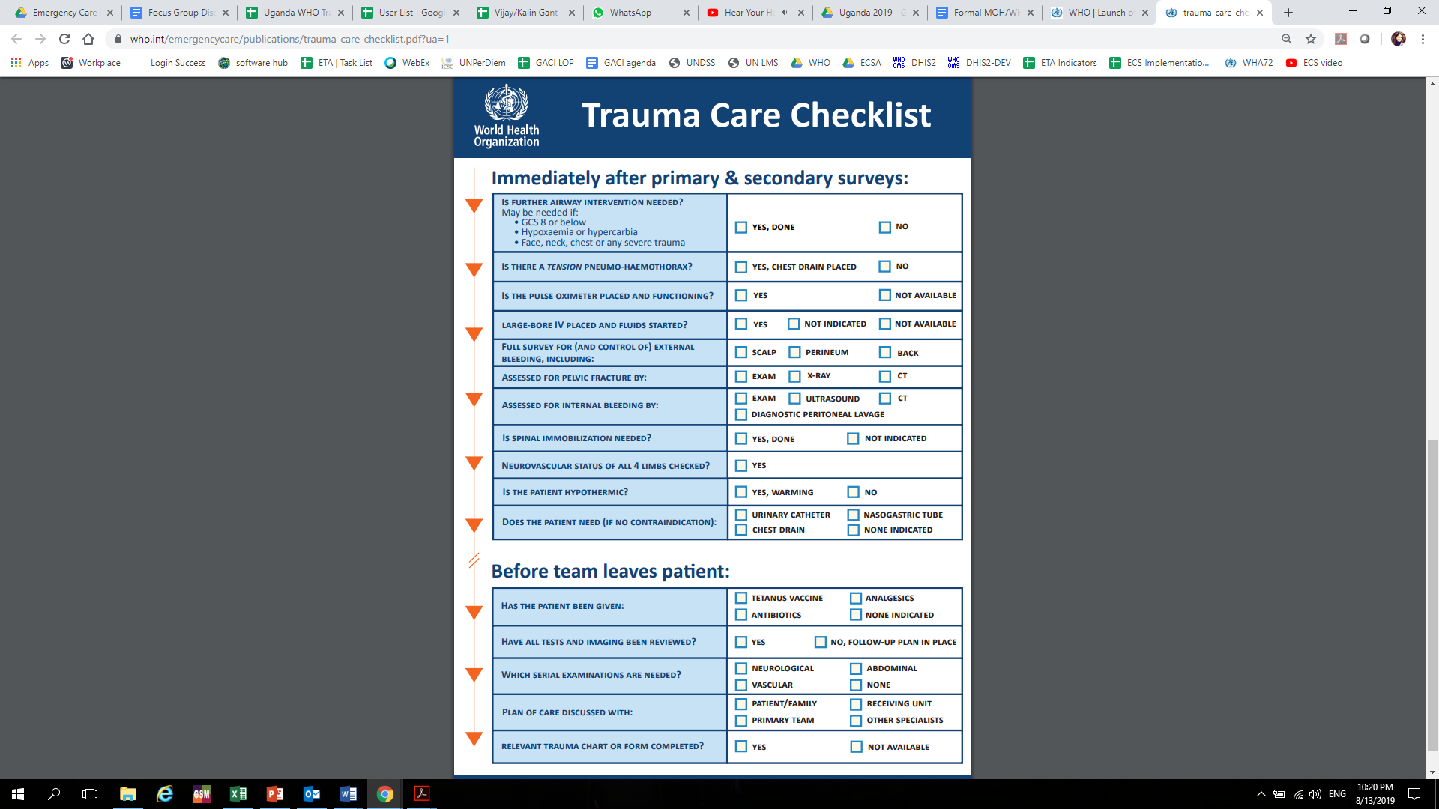
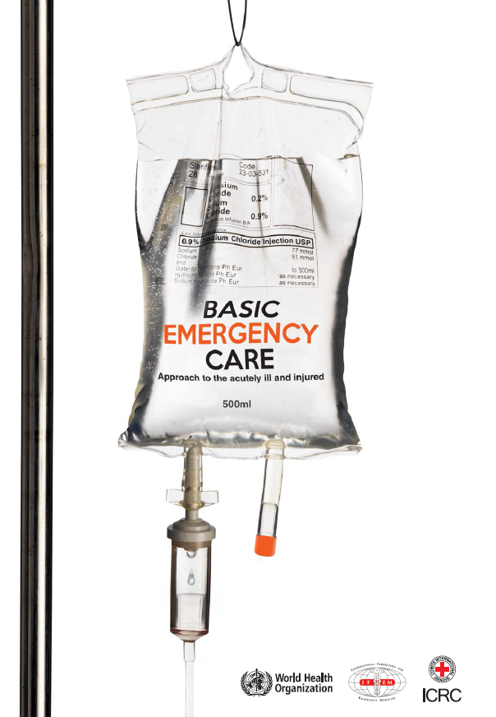
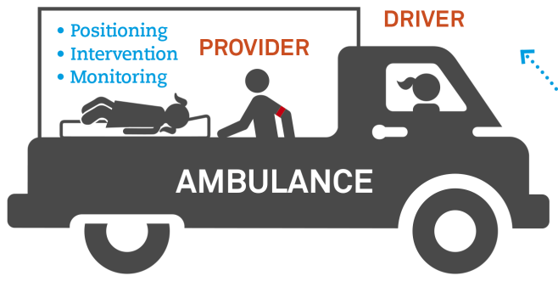
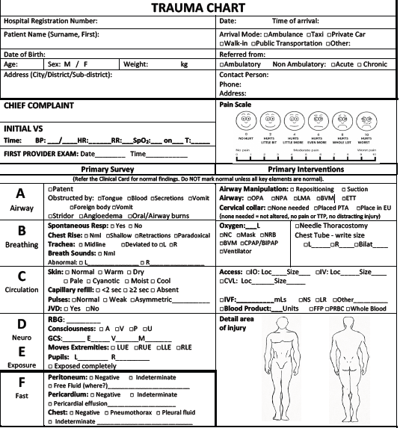

Emergency care resources based on priorities from countries
Shared challenges across countries
Policies to improve access to emergency care
WHO
Emergency
Care
System
Assessment
Areas targeted for priority action by countries
WHO Legislative toolkit
Formal triage and other protocols
Interagency Triage Tool,
WHO clinical checklists
Emergency care training
Developing prehospital systems
Standards for QI & data
WHO/ICRC/IFEM Basic Emergency Care
Toolkit of Standards & Protocols for prehospital systems
WHO Clinical Forms, Dataset & Registry
Notes:
Shared challenges across countries have been identified by the Emergency Care Systems Assessment (ECSA), conducted in over 30 countries. Areas for priority action are targeted during the ECSA process as well as through creation of a National Roadmap
ECSA is a structured appraisal of the essential emergency care system components in order to generate country-specific action priorities.
Legislative Toolkit
A toolkit that provides examples to support country development of laws on access to emergency care and protection of bystanders who assist the acutely ill and injured
Formal triage and other protocols
A range of clinical process guidance to improve the safety and quality of care, including a triage tool and checklists to ensure that no life-threatening conditions are missed and that timely, life-saving interventions are performed
Emergency Care Training
The WHO/ICRC Basic Emergency Care course is an open-access training course for frontline providers who manage acute illness and injury. It teaches a systematic approach to the initial assessment and management of time-sensitive conditions.
Standards for Quality Improvement and Data: Clinical Forms, Dataset, International Registry for Trauma and Emergency Care (IRTEC)
Standardized clinical forms facilitate systematic care delivery for every patient. The forms contain core data elements needed to guide quality improvement and system planning.
The WHO registry is a web-based platform free to users for aggregation and analysis of case-based data from emergency care visits. It is built on the DHIS2 platform.
Prehospital systems
WHO has a set of procedural standards and clinical protocols for prehospital systems, including for linkages with hospitals. that countries can adapt to their needs.

Slide 7
Clinical Care Guidance:
WHO/ICRC Basic Emergency Care Course
Open-access, short course
For frontline providers with limited diagnostic and therapeutic resources
Teaches systematic assessment and management of time-sensitive conditions in the acutely ill and injured
French, Spanish, Arabic and Russian translations available soon
Complementary Facilitator’s Workbook available soon
Notes:
Developed by WHO and International Committee of the Red Cross (ICRC), in collaboration with the International Federation for Emergency Medicine, Basic Emergency Care (BEC): Approach to the acutely ill and injured is an open-access training course for frontline healthcare providers who manage acute illness and injury with limited resources. Produced in response to requests from multiple countries and international partners, the BEC package includes a Participant Workbook, Facilitator Guide and electronic slide decks for each module. BEC teaches a systematic approach to the initial assessment and management of every injured person.
https://www.who.int/emergencycare/publications/Basic-Emergency-Care/en/

Slide 8
Clinical Process Guidance:
Interagency Integrated Triage Tool
Adult, Paediatric (<12), Prehospital and Surge
3 color and 4 color versions
Validated by large global collaboration
Notes:
Integrated Interagency Triage Tool, developed in a collaboration among WHO, ICRC, and Médecins Sans Frontières provides an integrated set of protocols for routine facility-based triage for adults and children, as well as for pre-hospital and surge triage. Formal triage helps ensure that people presenting with major trauma are identified early and their management prioritized.

Slide 9
Clinical Process Guidance:
WHO Clinical Checklists
Designed for use in emergency units
Emphasize key life saving elements of clinical care
Systematic approach to every injured (trauma checklist) or ill (medical checklist) person, ensuring life-saving interventions are performed and that no life-threatening conditions are missed
Reviews key actions at two critical points:
  Immediately after the ‘primary’ and ‘secondary’ surveys
  Before the team leaves the patient’s bedside
Developed and validated by large global collaboration
Notes:
Clinical process guidance includes the WHO Trauma Care Checklist, a simple list of key actions to ensure that no life-threatening conditions are missed and that timely, live-saving interventions are performed.
https://www.who.int/emergencycare/trauma-care-checklist-launch/en/

Slide 10
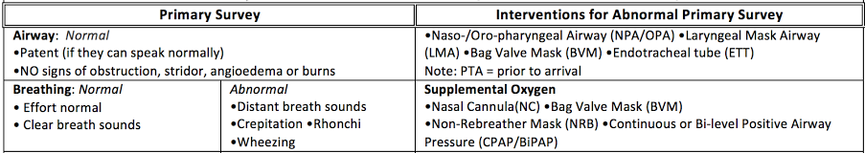
Clinical Process Guidance:
WHO Standardized Clinical Forms (and reference card)
Facilitate systematic care delivery for every patient
Sustainable collection of standardised data to guide quality improvement and system planning
Notes:
The WHO Standardized Clinical Form improves care by ensuring a systematic and structured approach to every injured person, and provides a simple mechanism for collecting the WHO registry data points.

Slide 11
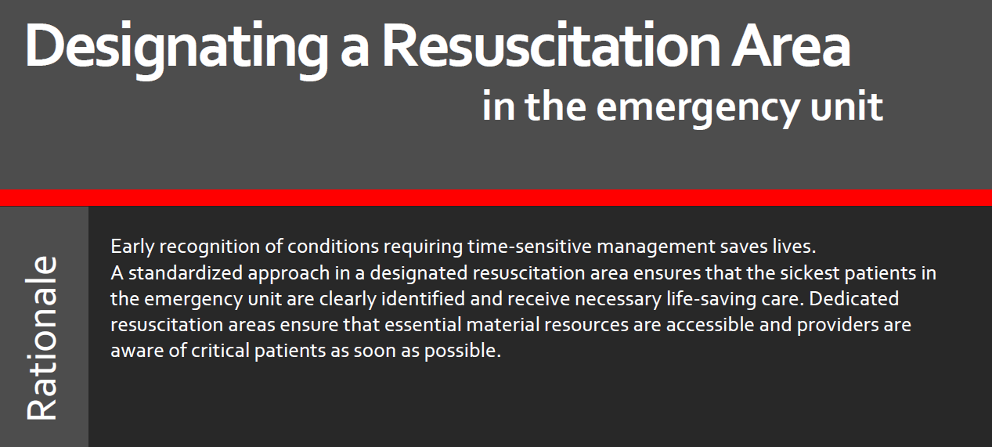
Clinical Process Guidance:
Resuscitation Area Designation
Provides guidance on:
  Space
  Material Resources
  Human Resources
  Use of the Area
Because we know
  Early recognition of critical patients saves lives;
  A designated resuscitation area ensures that critical patients are clearly identified to all staff and needed resources are at hand to deliver life-saving care
Notes:
The guidance on Resuscitation Area Designation describes a standardized approach to organize resuscitation areas and keep essential resources close at hand, ensuring the sickest patients in the emergency unit are clearly identified and receive needed care

Slide 12
Clinical Process Guidance:
Emergency Unit Management course
Systematic approach to management to improve quality of care in emergency units
For all senior clinical providers including nurses, clinical officers doctors
Builds crucial management skills
  Leadership
  Patient safety
  Emergency unit design and patient flow
  Quality improvement

Slide 13
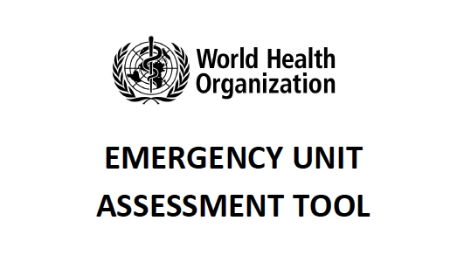
Hospital Emergency Unit Assessment Tool (HEAT)
Evaluates structure and key functions of an emergency unit
Developed from multiple validated instruments and tools
Identifies gaps that can be addressed by implementation of standards
Allows planners to develop targeted strategies for emergency unit improvements

Slide 14
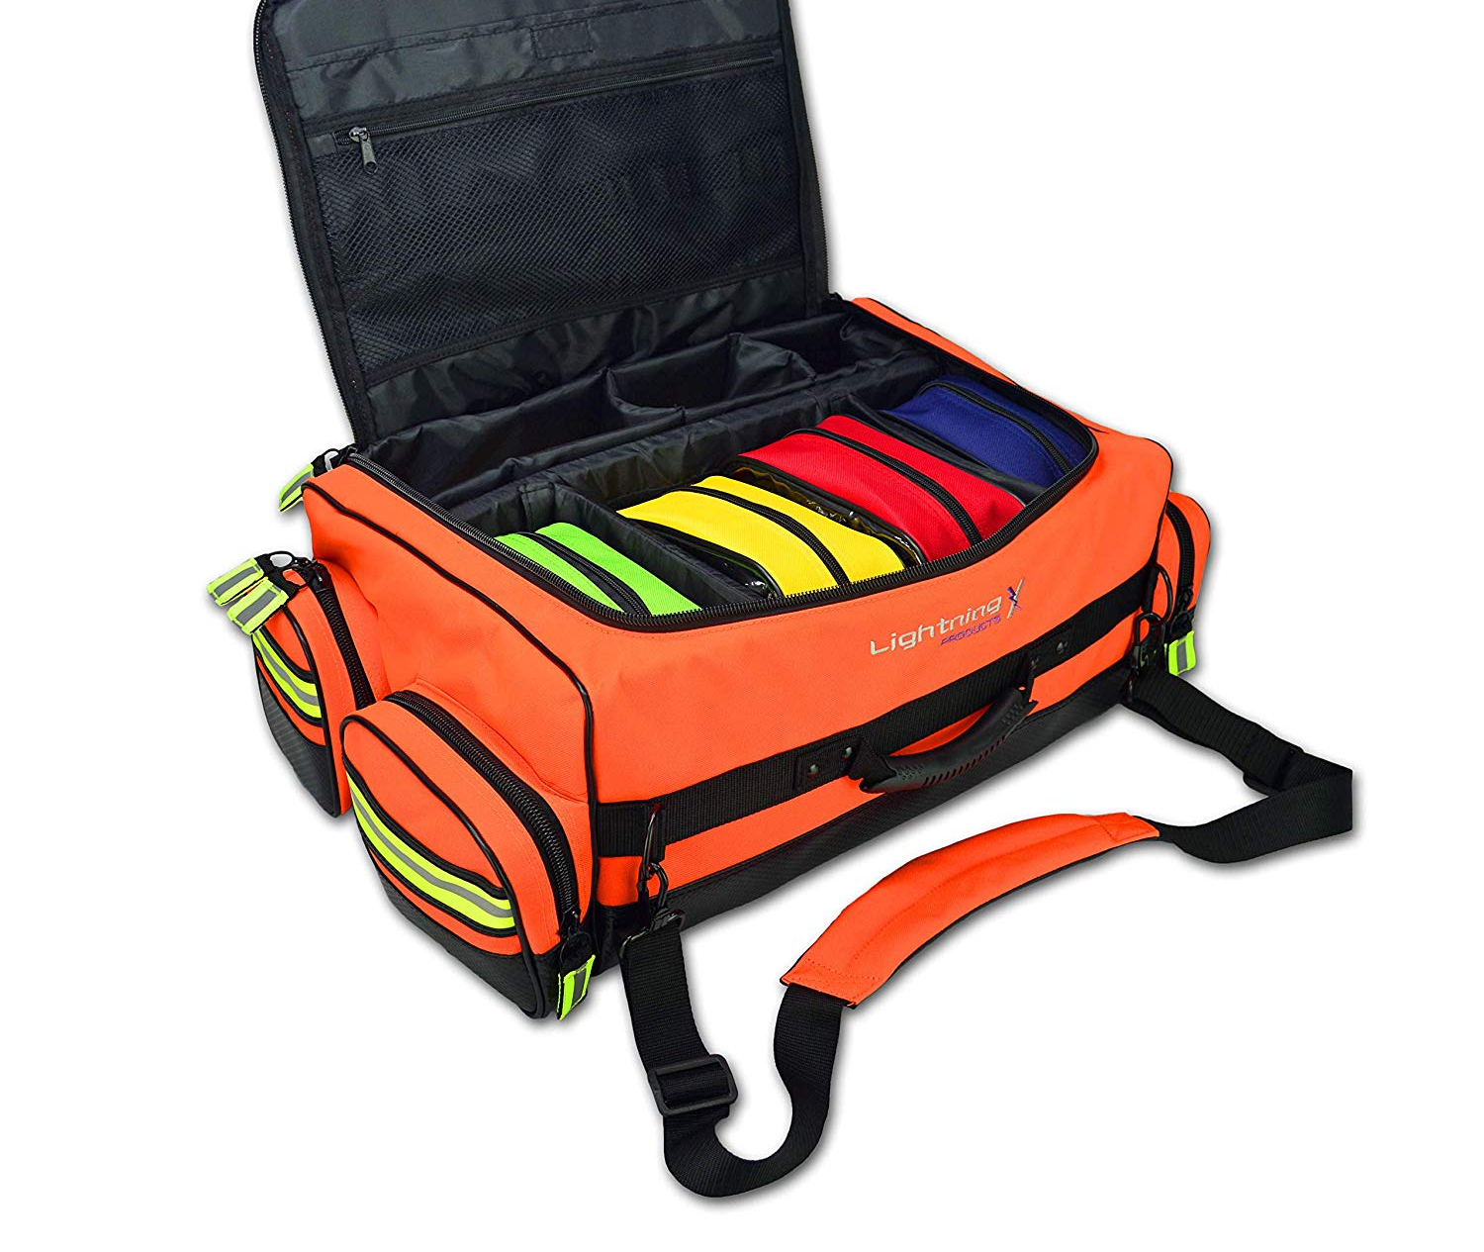
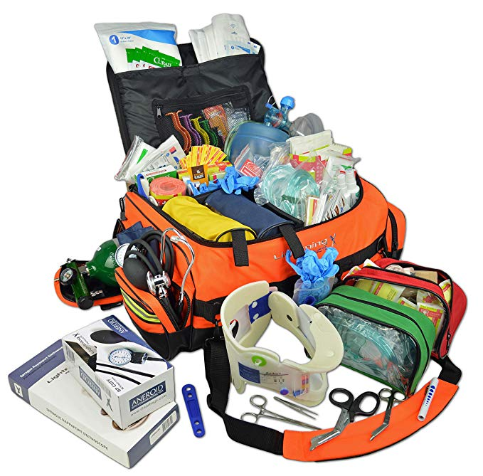
Essential Resources for Emergency
Care
Guidance for processes, design, data, protocols and resources needed in emergency care systems
For policymakers, planners and health professionals
Comprehensive list of resources for each level of a health system
  Emergency care services packages
  Essential medications
  Consumable and durable equipment

Slide 15
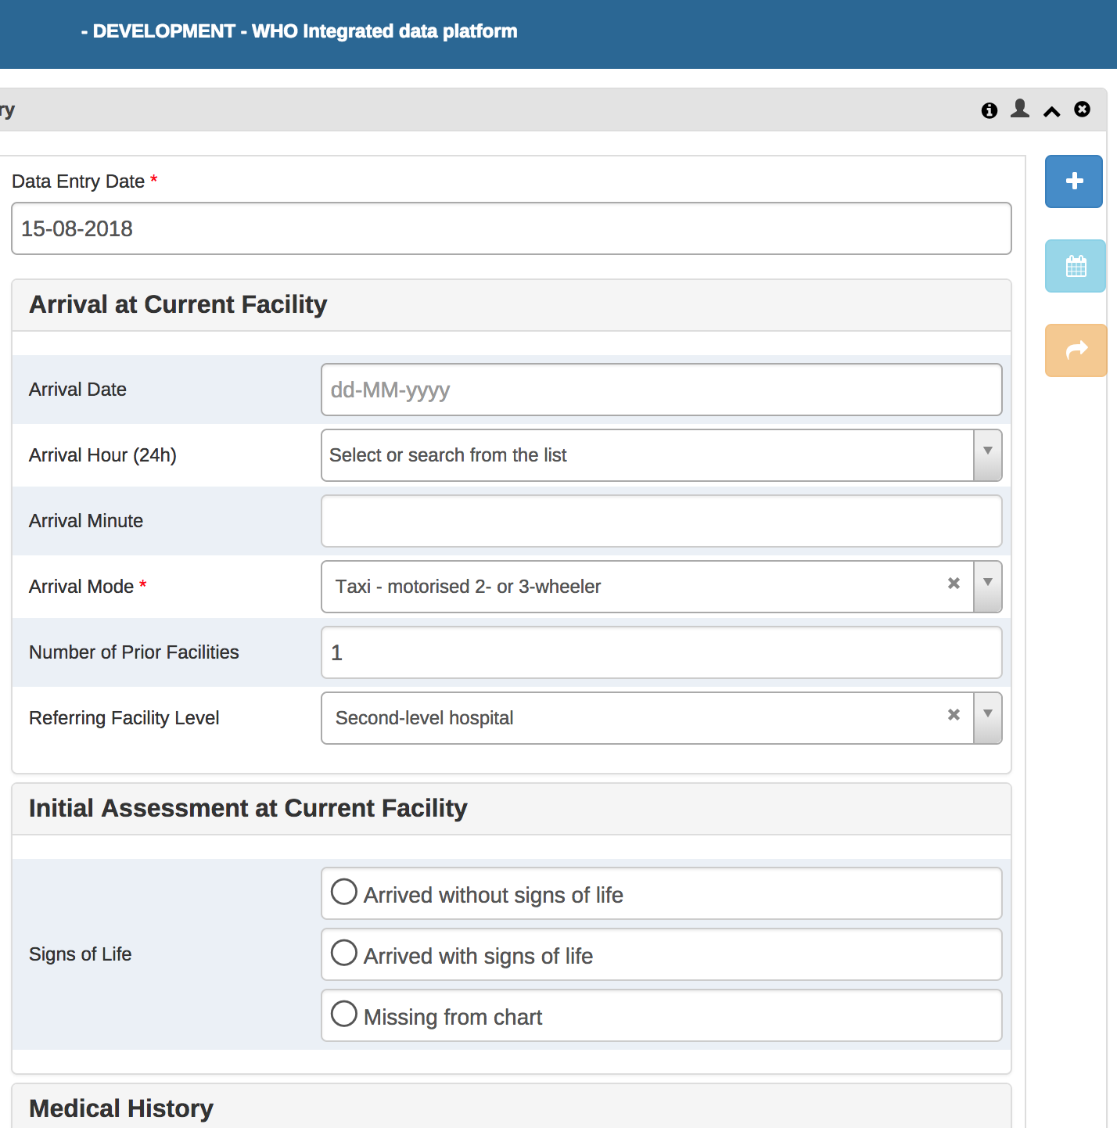
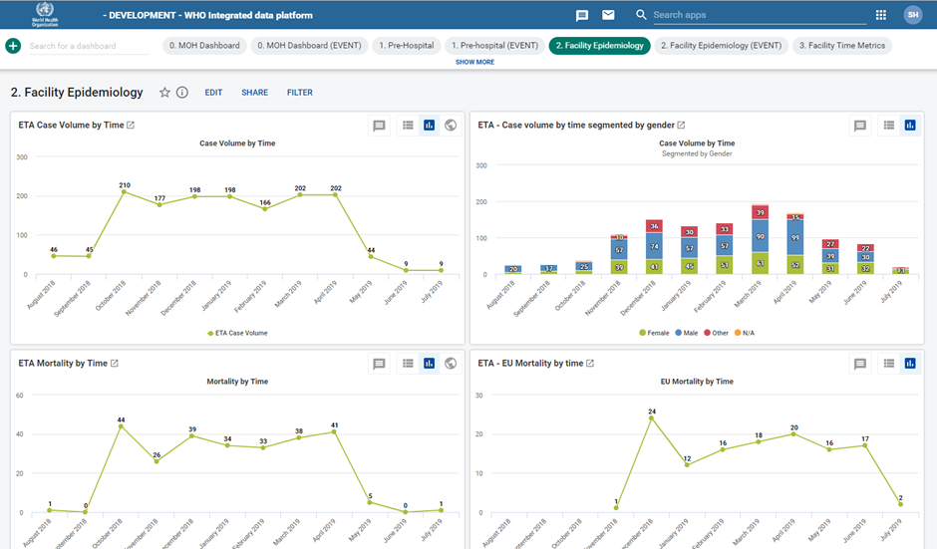
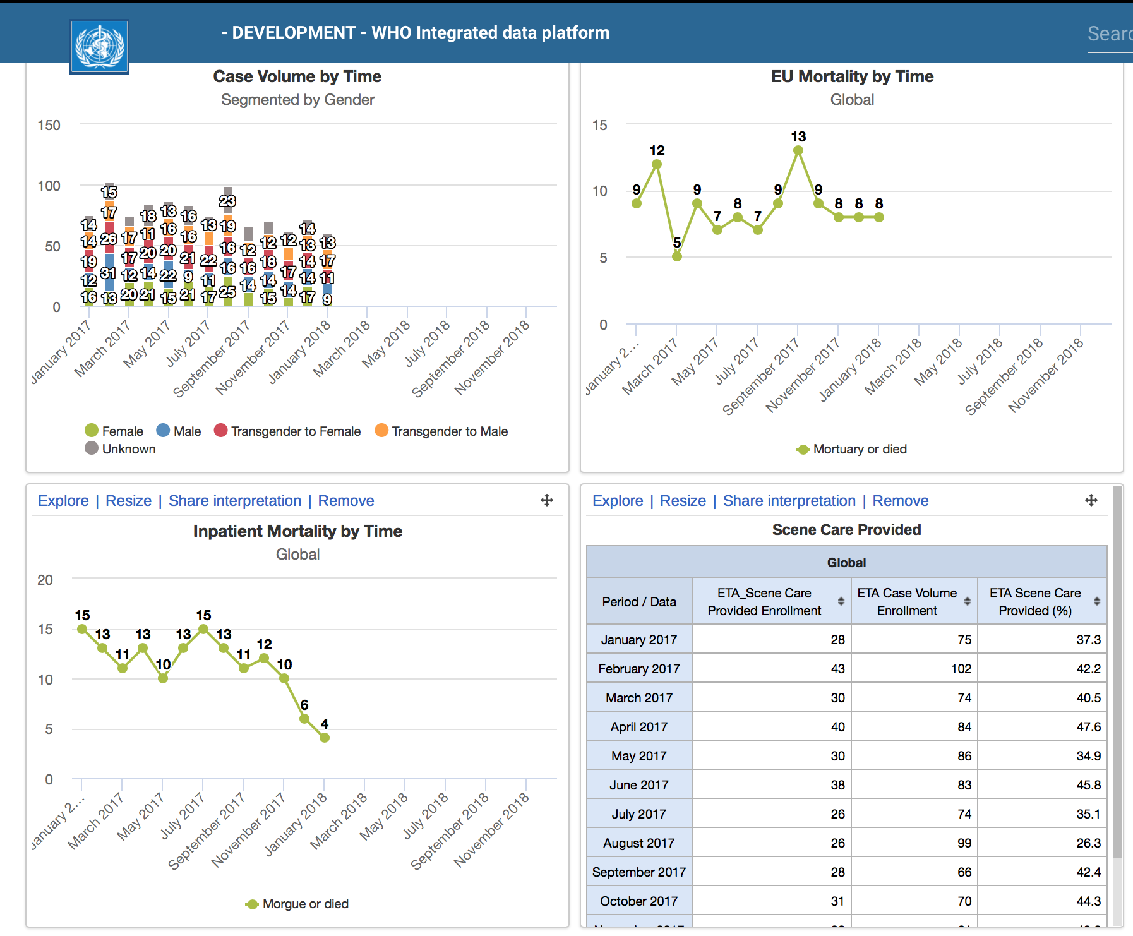
WHO International Registry for Trauma and Emergency Care (IRTEC)
DHIS2: web-based (soon tablet-based) platform
Single facility view or national aggregate view
Automatic aggregation and analysis of case-based data from emergency care visits
  Automated data visualizations and reports facilitate quality improvement, system planning and scholarly publication
Standardized audit filters allow rapid identification of cases where simple process changes can save lives
Customizable elements
Notes:
The WHO International Registry for Trauma and Emergency Care is a web-based platform for aggregation and analysis of case-based data from emergency care visits. The platform is free to users and provides a range of automated reports to facilitate quality improvement, system planning and scholarly publication. Standardized audit filters allow rapid identification of cases where simple process changes can save lives. The registry is currently available for use with acute injury cases presenting to facilities and will expand to include general emergency conditions in the coming year.
https://www.who.int/emergencycare/irtec/en/
https://drive.google.com/drive/folders/1bpkwjEH-f9_REmQXQEh4qnjQ_hG40oyb?usp=sharing

Slide 16
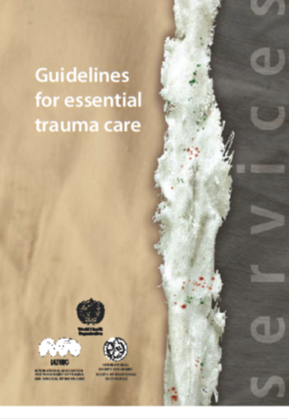
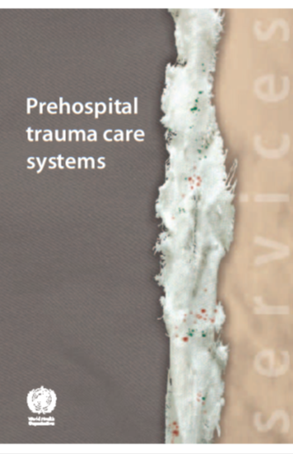
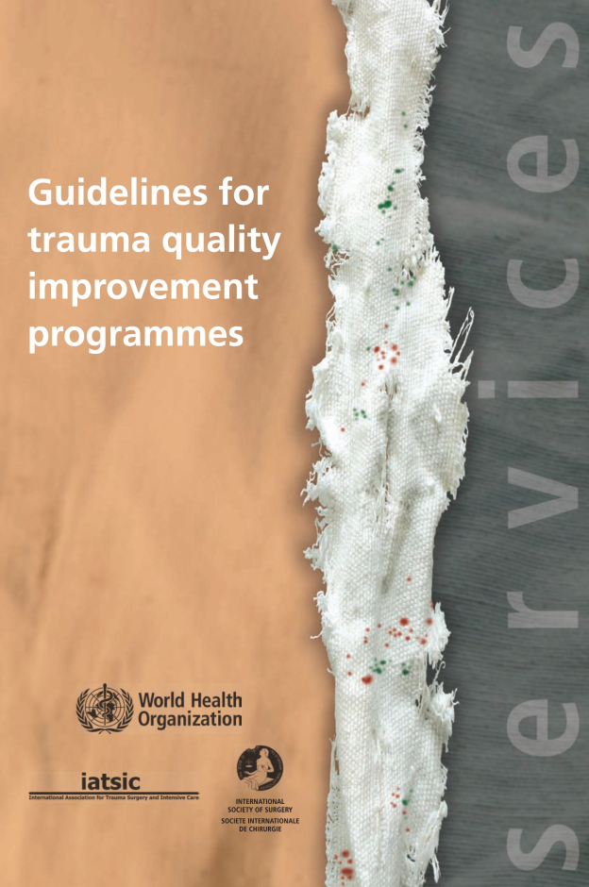
WHO Trauma Care Resources

Slide 17


