Slide 1


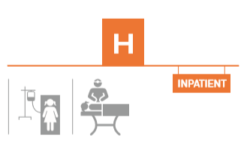
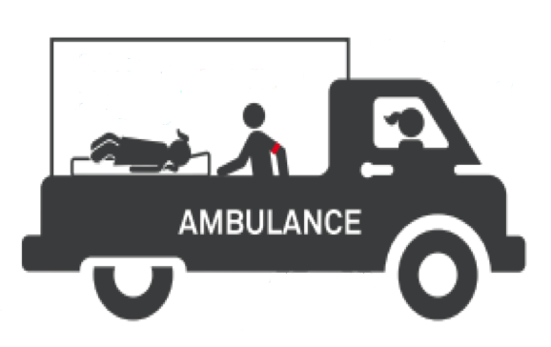
Timely care for the injured

Slide 2
HIV/TB/Malaria
36%
of development assistance for health
Trauma care
1%
Annual deaths in millions
Notes:
Injury kills nearly twice as many people each year as HIV, Malaria and TB COMBINED!
Despite this burden, the funding for care of the injured represents less than 1% of total Development Assistance for Health.
[Reference: Annual deaths from the WHO Global Health Observatory 2018
Injury: 4.88m deaths, Malaria: 446 000 deaths, HIV: 1m, TB: 1.29]
[Reference: Flows of Global Health Financing Seattle, USA: Institute of Health Metrics and Evaluation; 2018 [cited 2018 8/12/18]. Available from: https://vizhub.healthdata.org/fgh/.]
[Reference: Trauma care development and development assistance: opportunities to reduce the burden of injury and strengthen health systems; 2019. Available from: https://www.who.int/bulletin/volumes/97/5/18-213074/en/]

Slide 3
Injury deaths: what and where?
Where?
Street
Home
School
Sea, lakes and rivers
Workplace
What?
Notes:
Injuries occur at home, school, work, and, play.
Nearly a third of injury deaths are due to road traffic injuries
[Reference: WHO Global Health Estimates 2018.]

Slide 4

Road traffic injuries alone account for 1.35 million deaths per year
Fatality rates in low-income countries are nearly TRIPLE those in high-income countries
Road traffic fatality rates per 100,000 population
Road traffic injuries are the LEADING cause of death for those aged 5-29
Notes:
People in low and middle income countries are much more likely to die of road traffic injuries.

Slide 5
Insert local data slide
(injuries in local setting)
Notes:
Local injury BoD data can be inserted here, or the slide can be hidden, depending on local need. Such a local slide may show burden of injury, cost to the country, or similar data

Slide 6

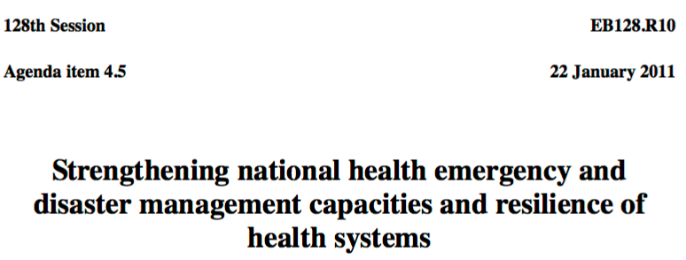
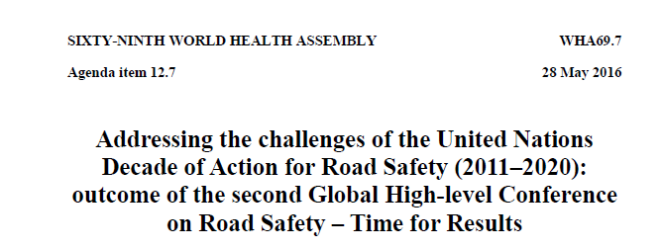
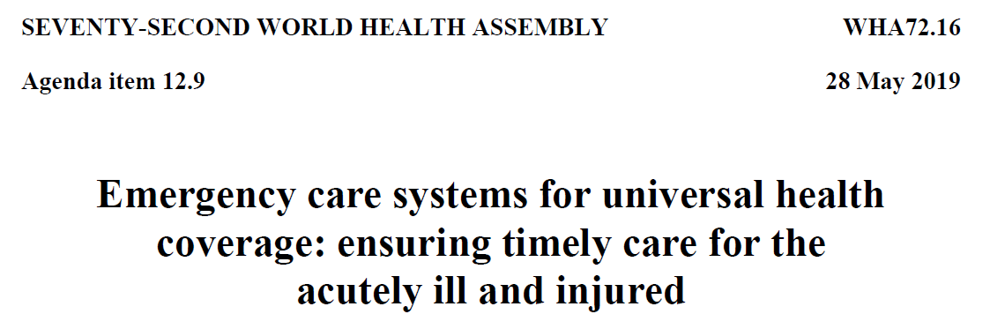
Global mandate: the World Health Assembly
Notes:
The UN and the World Health Assembly have called for strengthening of emergency trauma care

Slide 7
Timely emergency care saves lives
Notes:
This slide shows the essential functions of the emergency care system, from care at the scene, to transport and care in the facility. Every country, including ours, achieves these functions in some way; affordable, sustainable improvements can be made, building on this base.

Slide 8


Continuum of care for the injured
Bystanders
Pre-hospital
Hospital
Rehabilitation
  Simple actions can save lives
  Training for drivers and police is high impact
  Scene & transport care
  Trained and certified first responders improve outcomes
  Simple low-cost dispatch systems ensure timely care
  Systematic care for every injured person in the emergency unit
  Timely operative and critical care
  Maximizes impact of emergency and surgical care
  Getting people back to daily life
Notes:
Each component is essential and can be executed at any resource level.

Slide 9
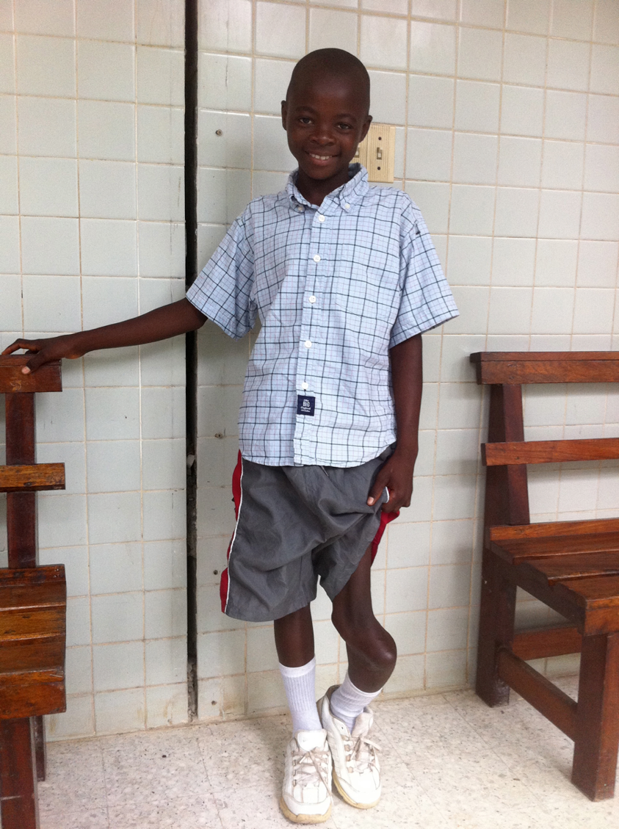
Injury care is a good investment
…and helps avoid the high costs of:
Early death
Complications
Prolonged recovery
Preventable disability
Lost wages and productivity for society
Notes:
[This can be replaced with a local example.]
Jon fell from a tree when he was 8 y/o trying to get mangos. There was no one at the local health facility able to treat his fracture with a simple procedure. He is now 11 years old and has difficulty walking and playing. He will face lifelong difficulties working and caring for his family .

Slide 10

Pre-hospital care is extremely cost-effective
Staffed community ambulance, rural
Staffed community ambulance, urban
Trained lay
first responders
and paramedics
Anti-retrovirals
for HIV
$284
$94
$7
$922
COST PER LIFE YEAR GAINED
Notes:
Based on the World Bank Disease Control Priority project, provision of prehospital care is extremely cost effective – as low as $7 per year life gained for combination systems using lay people and professional paramedics, compared to $922 for ARVs for HIV!
[Reference: http://dcp-3.org/chapter/2586/implications-urgent-care-needs-health-systems]

Slide 11
Hospital care is extremely cost-effective
Surgical care for injured patients
  SIERRA LEONE $32
  CAMBODIA $78
  NIGERIA $172
  HAITI $223
COST PER DALY AVERTED
Notes:
Surgery for injury is highly cost effective when compared to other hospital interventions-- as low as $32 per DALY averted, compared to $1059 for MDR TB treatment
References:
Disease Control Priorities, 3rd edition: http://dcp-3.org/chapter/2586/implications-urgent-care-needs-health-systems
Hospital care:
https://www.ncbi.nlm.nih.gov/pubmed/16528459
https://www.ncbi.nlm.nih.gov/pubmed/18716830
https://www.ncbi.nlm.nih.gov/pubmed/19771466

Slide 12
Rehabilitation makes emergency care more cost-effective
Post-operative rehabilitation DECREASED
length of stay and cost by
$1600
per patient

Slide 13

^{3.6} By 2020, halve the number of global deaths and injuries from road traffic accidents
Post-crash emergency care and rehabilitation could avert around 40% of these deaths
^{3.8} Achieve universal health coverage
including financial risk protection & access
to quality essential health-care services….
Timely emergency care access is critical to effective universal health coverage
Notes:
In 2015, 193 of the United Nations Member States developed and endorsed the Sustainable Development Goals. Emergency care is essential to many targets, NOT ONLY those on road traffic injury and UHC, but also many others…

Slide 14
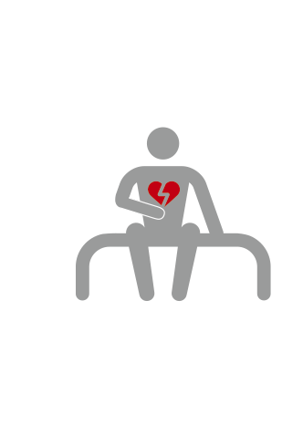
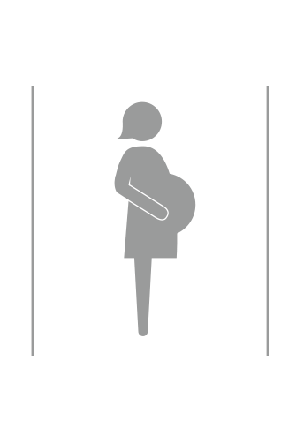












Emergency care can also contribute to the achievement of 10 other SDG targets, by addressing:
-Noncommunicable diseases
-Obstetrics
-Child health
-Disasters
-Violence
Beyond injury
Notes:
While emergency care is essential for injury, it also has enormous impact on NCDs (eg, heart attacks and strokes), child health (eg pneumonia, shock), maternal deaths (pregnancy-related bleeding), and disaster response.

Slide 15
Impact of emergency care
Over HALF of deaths and a THIRD of disability in low- and middle-income countries are from conditions treatable by emergency care
Notes:
***format text in more interesting way

Slide 16
Where are we now and what do we need?
Local slide outlining what is already in place in your country, and major gaps.
Mention successful emergency care strengthening efforts in nearby countries
Emphasize the importance of being leaders in emergency care development and not being left behind
Global Alliance for Care of the Injured – Advocacy slide deck

Slide 17
So what do we know?
Injuries are a leading cause of death and disability
Injury death rates are much higher in low- and middle- income countries
Emergency care is effective at limiting the impact of injuries and at improving outcomes
Emergency care is a great integrated investment, improving outcomes of a range of health conditions
The UN and World Health Assembly have called for urgent action to strengthen emergency care
Well-organized emergency care systems will help to achieve many of the SDGs.

Slide 18
What next?
Train frontline providers in basic emergency care
Conduct a national assessment with the WHO Emergency Care Systems Assessment
Implement the WHO Trauma Care Checklist and the WHO/ICRC Integrated Triage Tool
Conduct facility level assessments on emergency trauma care capacity
Collect and use data for facility quality improvement initiatives via the WHO International Registry for Trauma and Emergency Care

Slide 19
WHO resources
Essential Trauma Care Volumes
Basic Emergency Care Course
Trauma Care Checklist
Triage Tools
Emergency Care System Assessment (ECSA)
Hospital Emergency Unit Assessment Tool
International Registry for Trauma and Emergency Care (IRTEC)
Notes:
There are many resources freely available to help implement a trauma care system; here are some of them

Slide 20
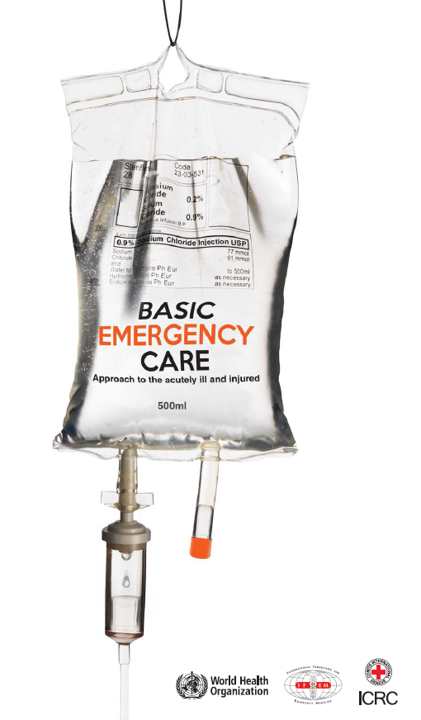
WHO Basic Emergency Care Course
Open-access, short course
For frontline providers with limited diagnostic and therapeutic resources
Trauma module teaches systematic assessment and management of high-risk injuries, Trauma Primary and Secondary Surveys and critical interventions for high-risk conditions
Other modules on shock, difficulty in breathing, and altered mental status teach systematic approach to the initial assessment and management of time-sensitive conditions in the undifferentiated acutely ill

Slide 21
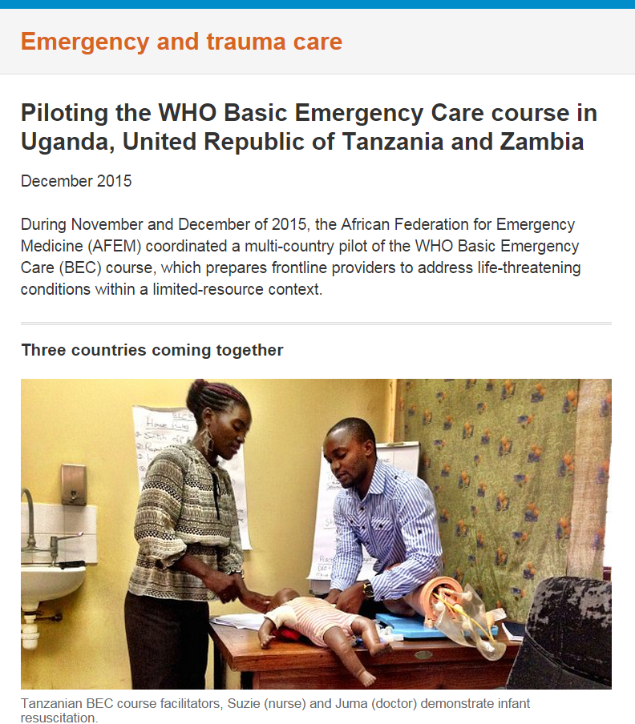

Slide 22



WHO Essential Trauma Care

Slide 24
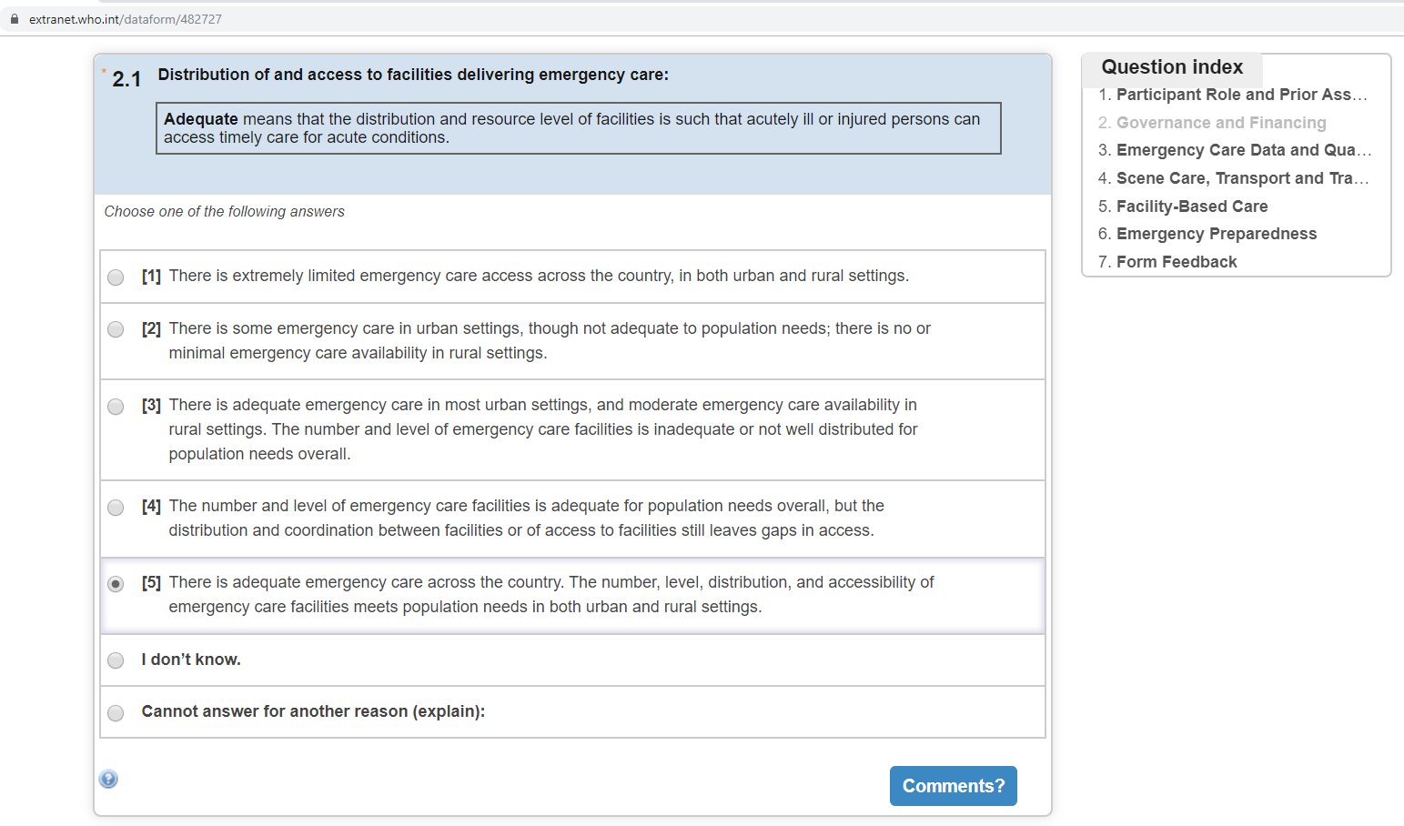
WHO ECSA Online

Slide 25
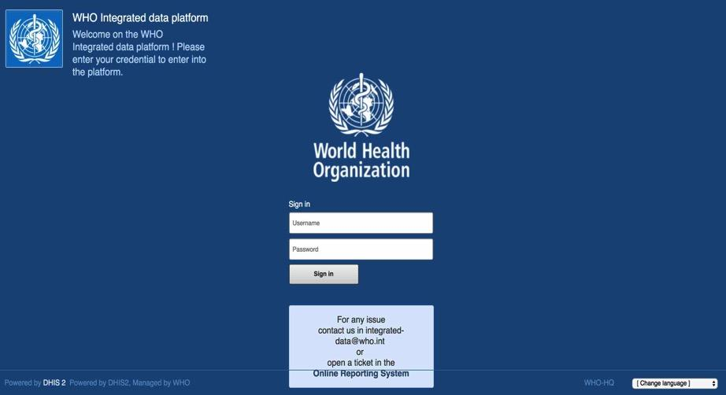
WHO International Registry for Trauma and Emergency Care (IRTEC)

